Slide 1
BERT-PLI: Modeling Paragraph-Level Interactions for Legal Case Retrieval
Yunqiu Shao, Jiaxin Mao, Yiqun Liu, Weizhi Ma, Ken Satoh, MinZhang and Shaoping Ma

Slide 2
Contents
Introduction
Approach
Experiments
Conclusion

Slide 3
Contents
Introduction
Approach
Experiments
Conclusion

Slide 4
Introduction
Legal case retrieval is a specialized Information Retrieval task that involves retrieving supporting cases given a query case.
Why we need Legal case retrieval?

Slide 5
Introduction
Legal case retrieval is a specialized Information Retrieval task that involves retrieving supporting cases given a query case.
Why we need Legal case retrieval?
Precedents
Notes:
Precedents (case laws) are a primary source of laws in the common law system, which is fundamental for a lawyer’s court preparations.

Slide 6
Challenges
Extreme long texts
The definition of relevance in the legal scenario is somehow beyond the general definition of topical relevance.
Collecting a large dataset for this task can be challenging
Notes:
Relevant cases are those that can support the decision of the current case, which usually involve similar situations and suitable laws. Therefore,
it is crucial to identify the similarities in the aspects of legal issues and legal processes of the cases, which calls for semantic understanding of whole documents.
For one thing, downloading large-scale legal documents is restricted in many law systems. For another, it is quite expensive to obtain accurate relevance
judgments since it requires expert knowledge in the legal domain. The lack of data brings obstacles to the training process of deep neural models.

Slide 7
Challenges
Challenge1: Paragraph-Level Interactions (PLI)
Challenge2: Model semantic interactions with BERT
Challenge3: Finetune

Slide 8
Task Description
The legal case retrieval task involves finding prior cases that
should be noticed concerning a given query case in the set of candidate cases
Noticed case is a legal technical term denoting that a precedent is relevant to a query case (supports the decision of a query case).

Slide 9
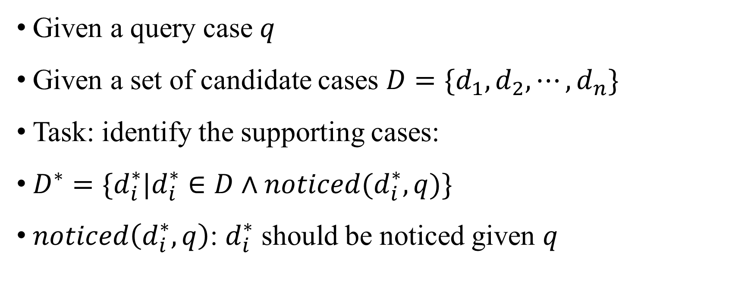
Task Description
Given a query case $q$
Given a set of candidate cases $D=\{d_{1},d_{2},⋯,d_{n}\}$
Task: identify the supporting cases:
$D^{∗}=\{d_{i}^{∗}|d_{i}^{∗}∈D∧noticed(d_{i}^{∗},q)\}$
$noticed\left(d_{i}^{∗},q\right)$: $d_{i}^{∗}$ should be noticed given $q$
Notes:
Both the query and the candidates are legal documents containing long texts, which consist of the facts in a case

Slide 10
Contents
Introduction
Approach
Experiments
Conclusion

Slide 11
Multi-Stage Pipeline
Stage 1: BM25 Selection
Stage 2: BERT Fine-tuning
Stage 3: BERT-PLI

Slide 12
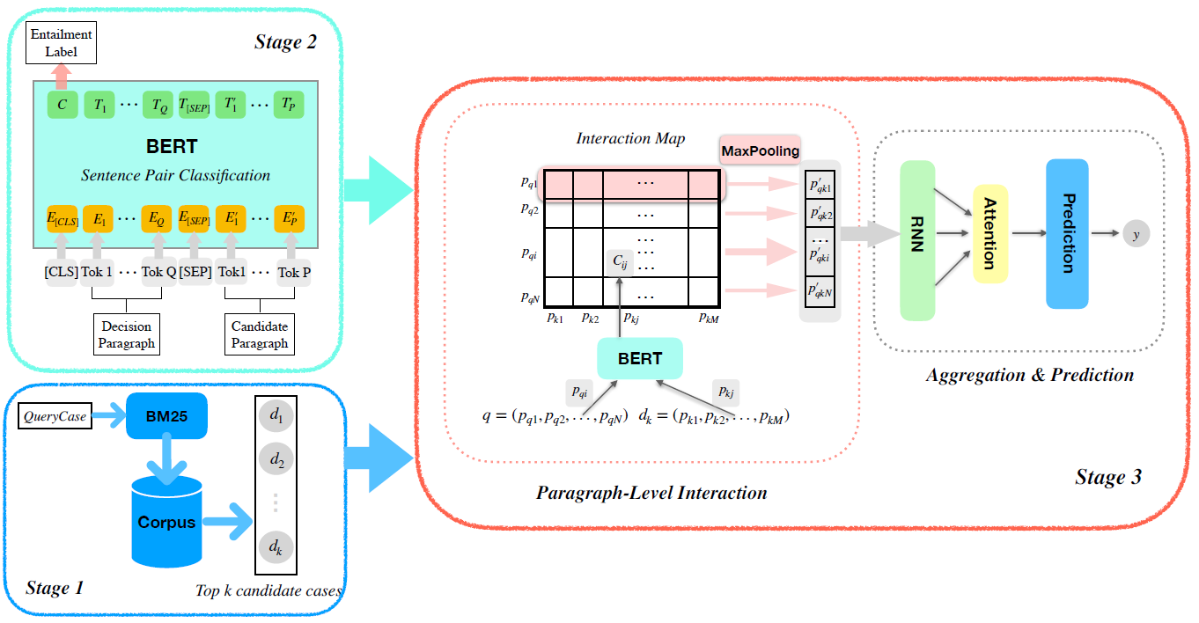
Multi-Stage Pipeline
Notes:
Deep learning models are usually time-consuming and resource-consuming. Considering the computational cost, we employ the cascade framework which utilizes BM25 to
prune the set of candidates.
BM25: traditional information retrieval model like tf-idf

Slide 13
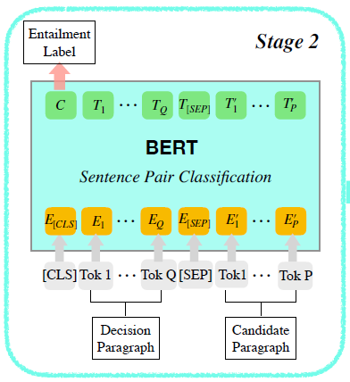
Finetune Task
Task: Given a decision Q of a new case and a relevant case R, a specific paragraph that entails the decision Q needs to be identified.
Data sample: {"text_a": "Content of the decision paragraph of the 1st query case. ", "text_b": "Text of the xth paragraph.", "label": 0}
Notes:
fine-tune it with a small-scale legal case entailment dataset COLIEE 2019 Task 2 (Challenge3)
Binary Classification task

Slide 14
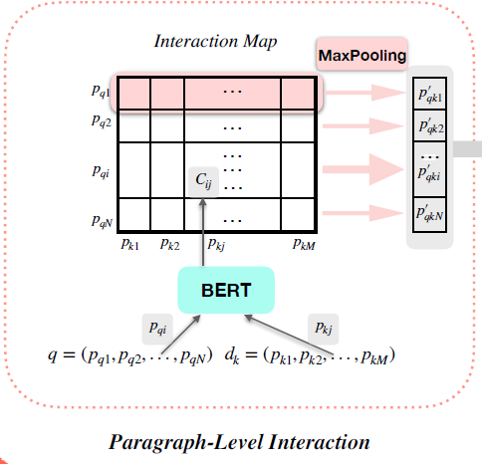

Slide 15

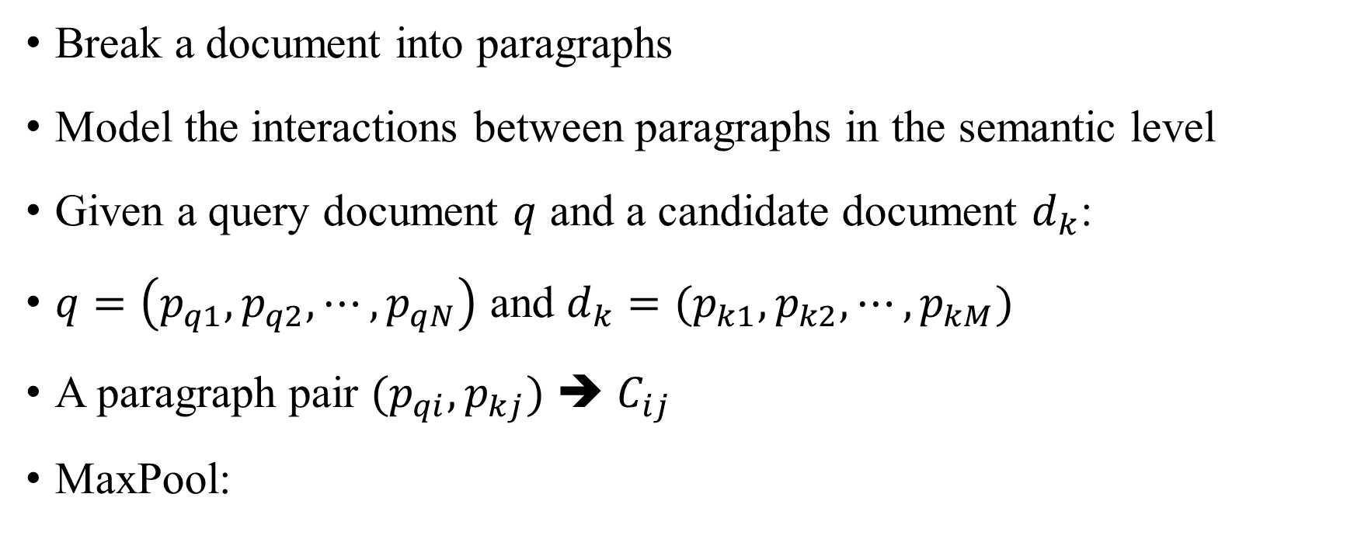
BERT-PLI
Break a document into paragraphs
Model the interactions between paragraphs in the semantic level
Given a query document $q$ and a candidate document $d_{k}$:
$q=\left(p_{q1},p_{q2},⋯,p_{qN}\right)$ and $d_{k}=(p_{k1},p_{k2},⋯,p_{kM})$
A paragraph pair ${(p}_{qi}, p_{kj})$ ➔ $C_{ij}$
MaxPool:

Slide 16
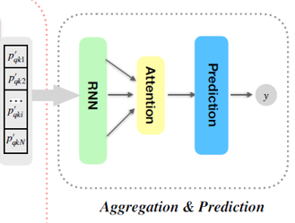

Slide 17
Contents
Introduction
Approach
Experiments
Conclusion

Slide 18
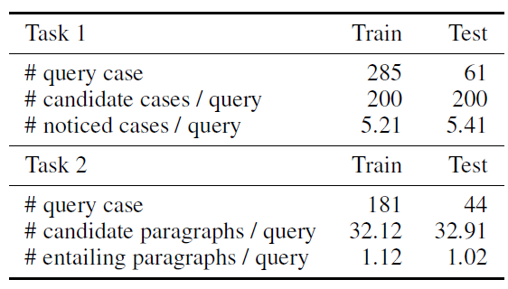
Dataset: COLIEE 2019

Slide 19
Baseline Methods
Traditional bag-of-words retrieval models: VSM, BM25 and LMIR
Deep retrieval models: ARC-II and MatchPyramid
Methods in the competition: JNLM and ILPS

Slide 20
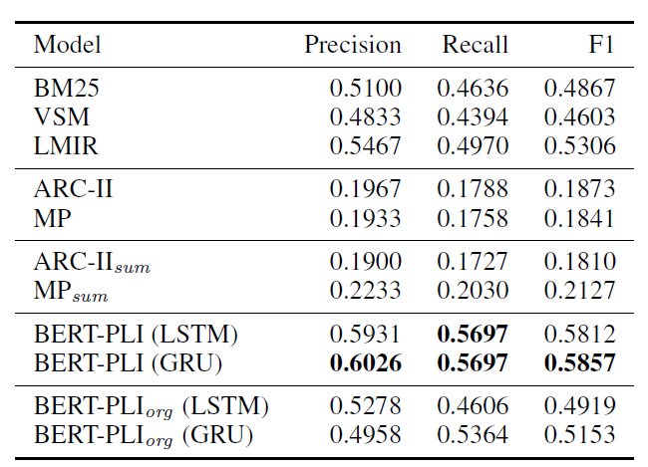
Baseline Methods
Notes:
Stage 1: K = 50 (top 50 candidates for each query) -> recall > 0.9 -> brings little harm to the overall retrieval performance
Bert-PLI: We set and N = 54 M = 40, which can cover 3/4 of paragraphs in most query and candidate cases
Finally 5 documents (widely used number)

Slide 21
Baseline Methods
Notes:
deep learning retrieval models perform much worse than the traditional retrieval models in this task
2. automatic summarization techniques to shorten the input length (no help) TextRank
Reason: legal documents contain plenty of information and complex logic, it is hard to express them well in a much -> the importance of considering
the full document information

Slide 22
Baseline Methods
Notes:
Org: no finetune
Important to finetune

Slide 23
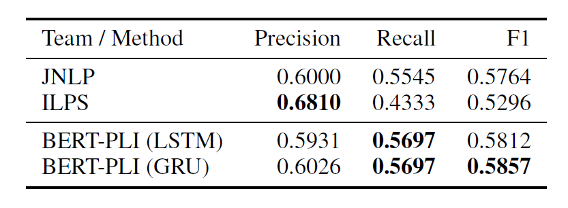
Baseline Methods

Slide 24
Contents
Introduction
Approach
Answerability
Conclusion

Slide 25
Conclusion
Challenges: Long text, relevance definition and lack of large dataset
Approaches: PLI, Bert and Finetune

Slide 26
Q&A

